Slide 1

The Role of Epithelial Cytokines in Asthma

Slide 2
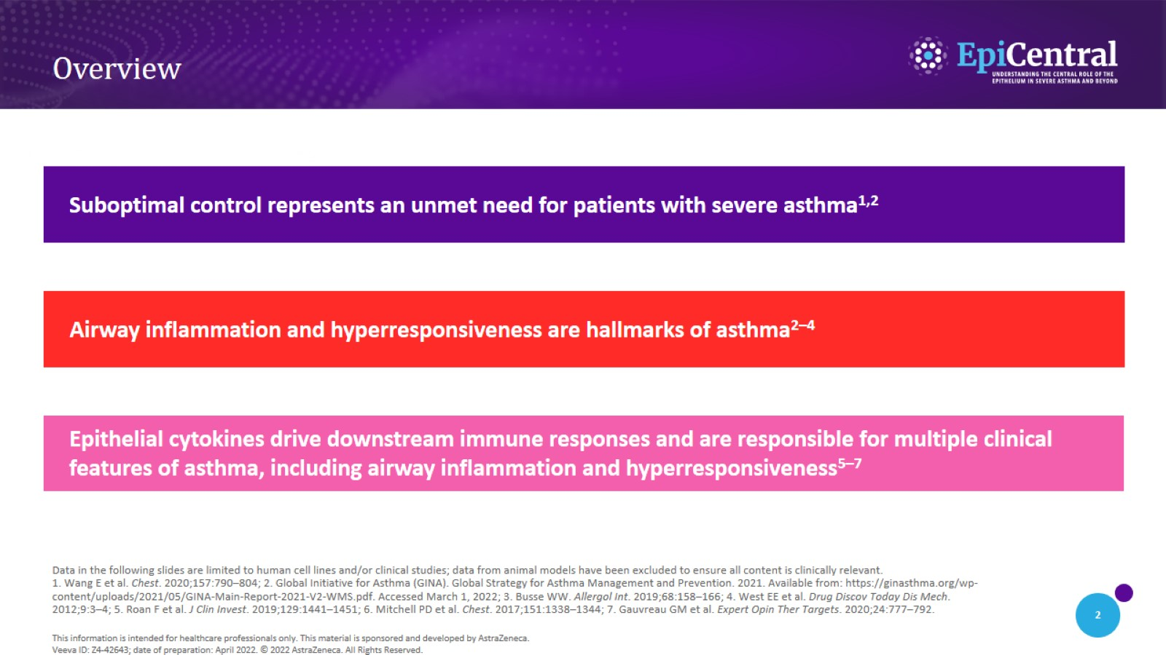
Overview

Slide 3

The Unmet Needs in
Severe Asthma

Slide 4
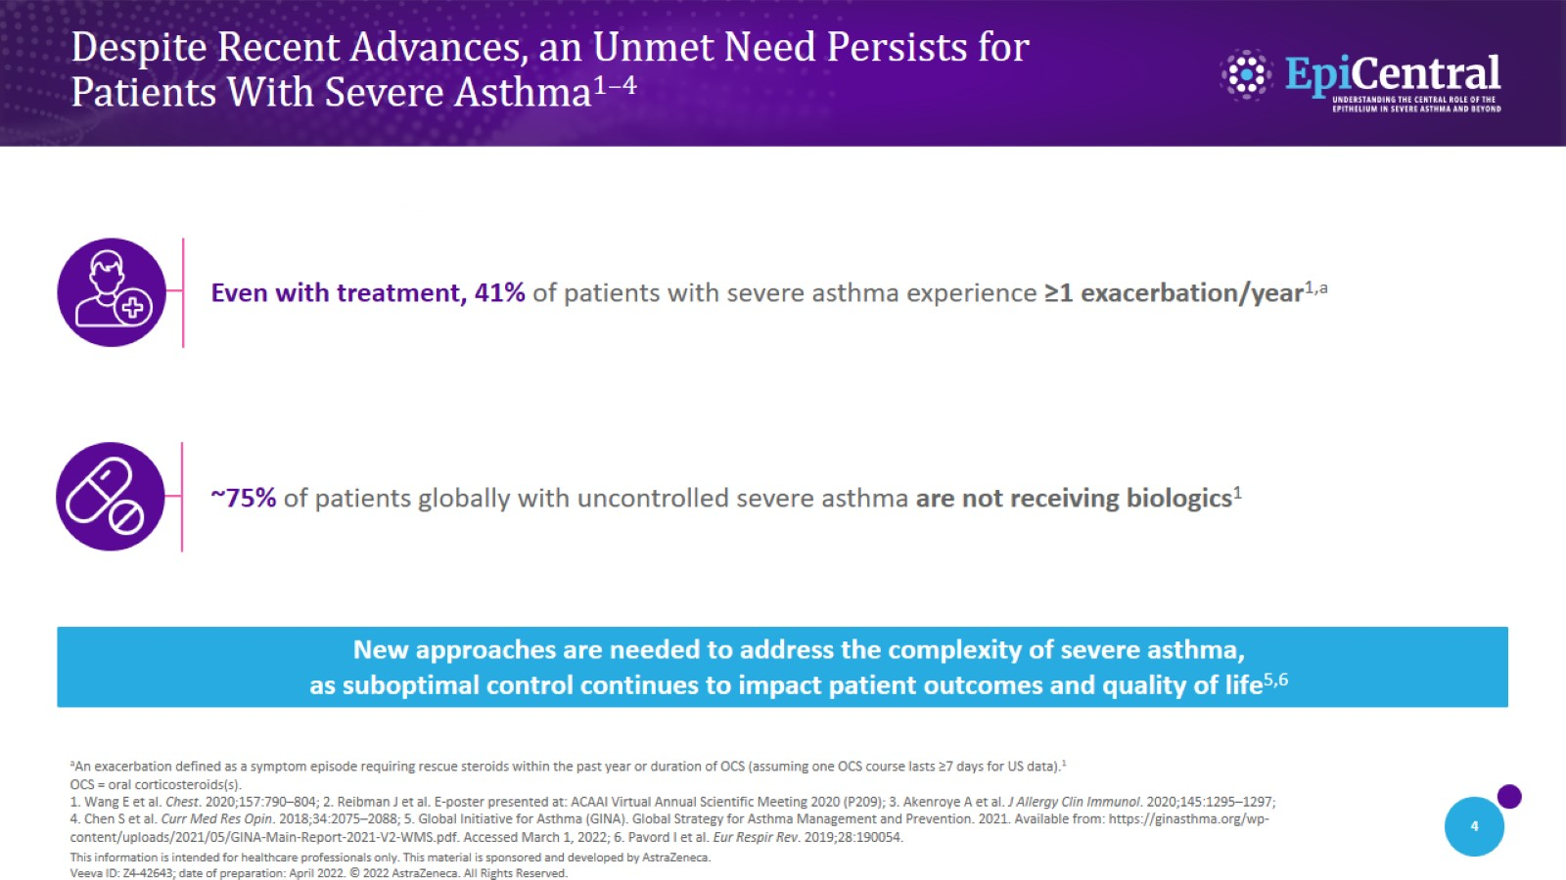
Despite Recent Advances, an Unmet Need Persists for
Patients With Severe Asthma^{1–4}

Slide 5
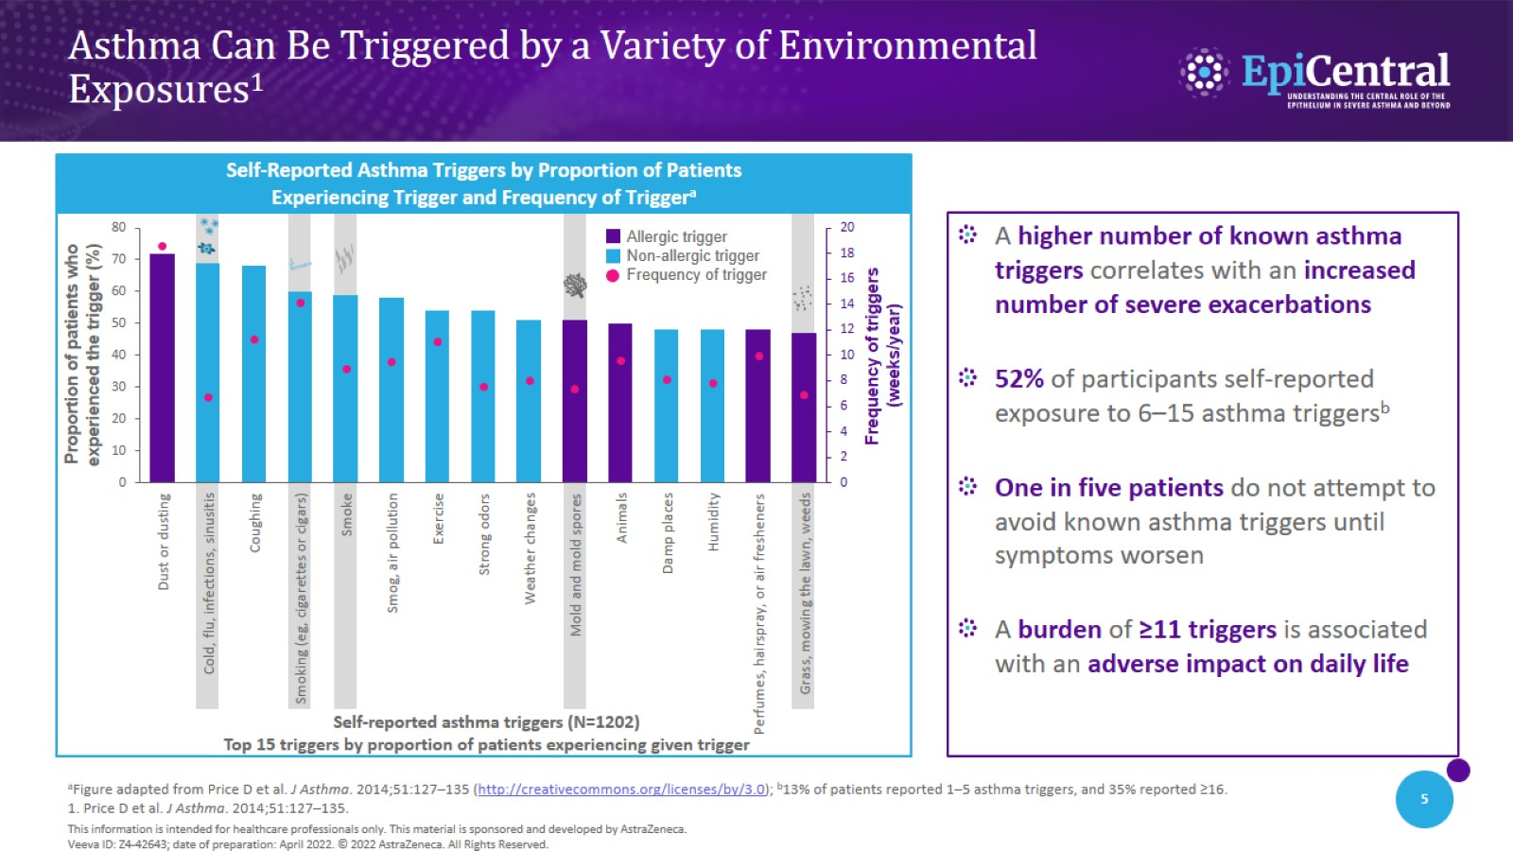
Asthma Can Be Triggered by a Variety of Environmental
Exposures¹

Slide 6
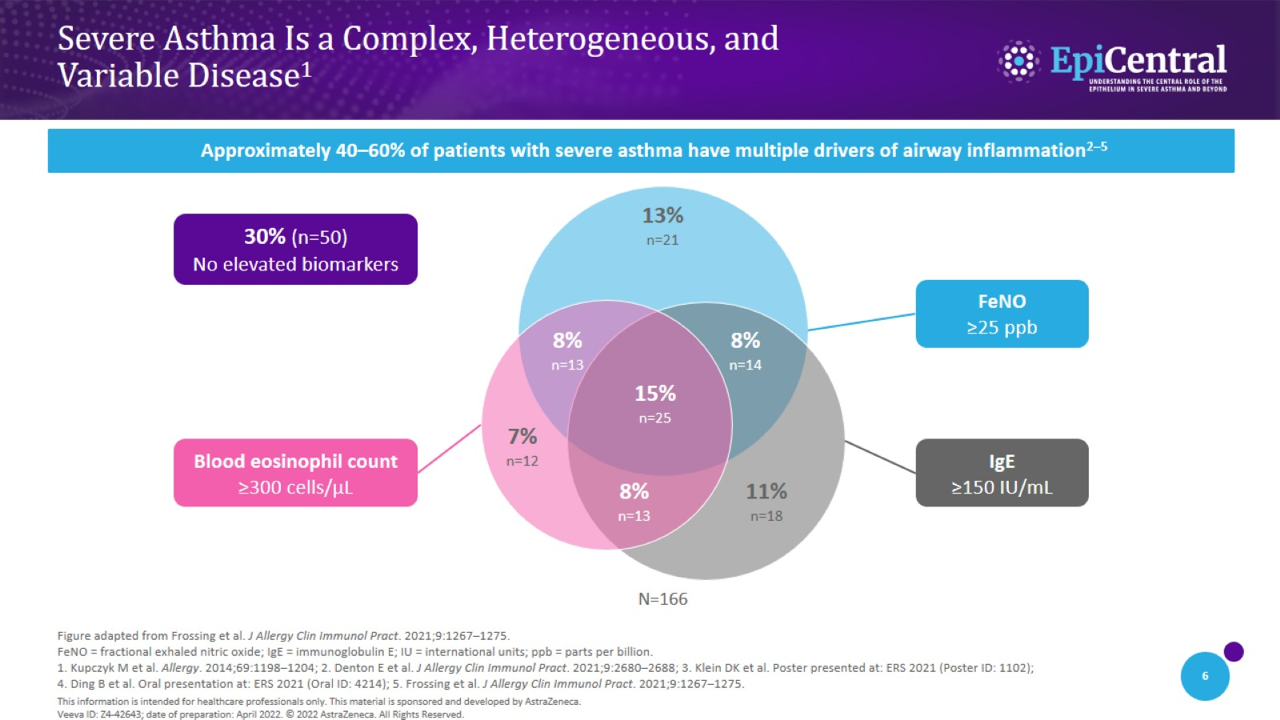
Severe Asthma Is a Complex, Heterogeneous, and
Variable Disease¹

Slide 7

The Epithelium Drives Hallmarks of Asthma

Slide 8
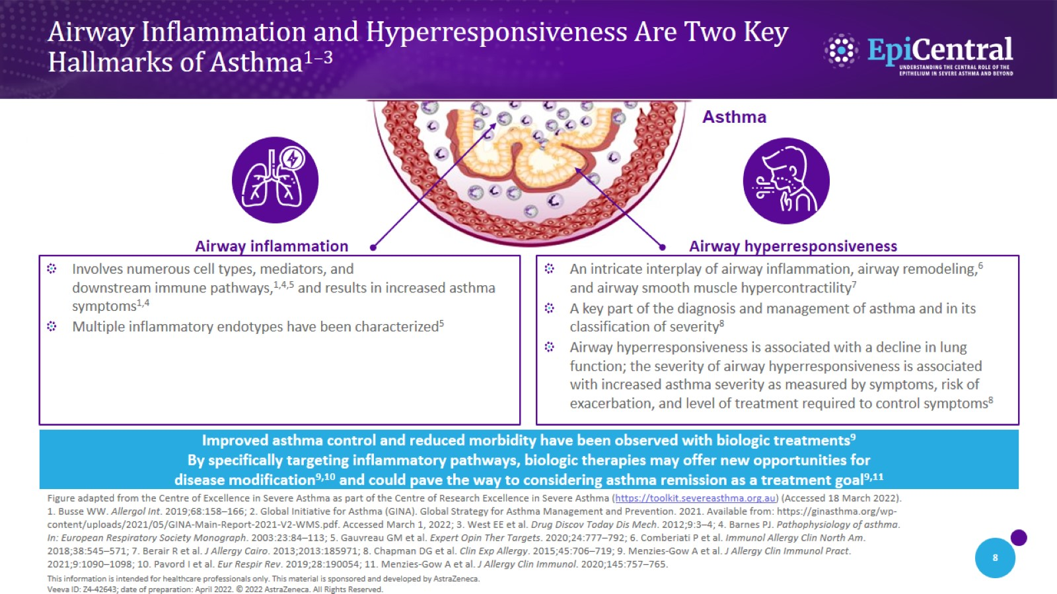
Airway Inflammation and Hyperresponsiveness Are Two Key
Hallmarks of Asthma^{1–3}

Slide 9
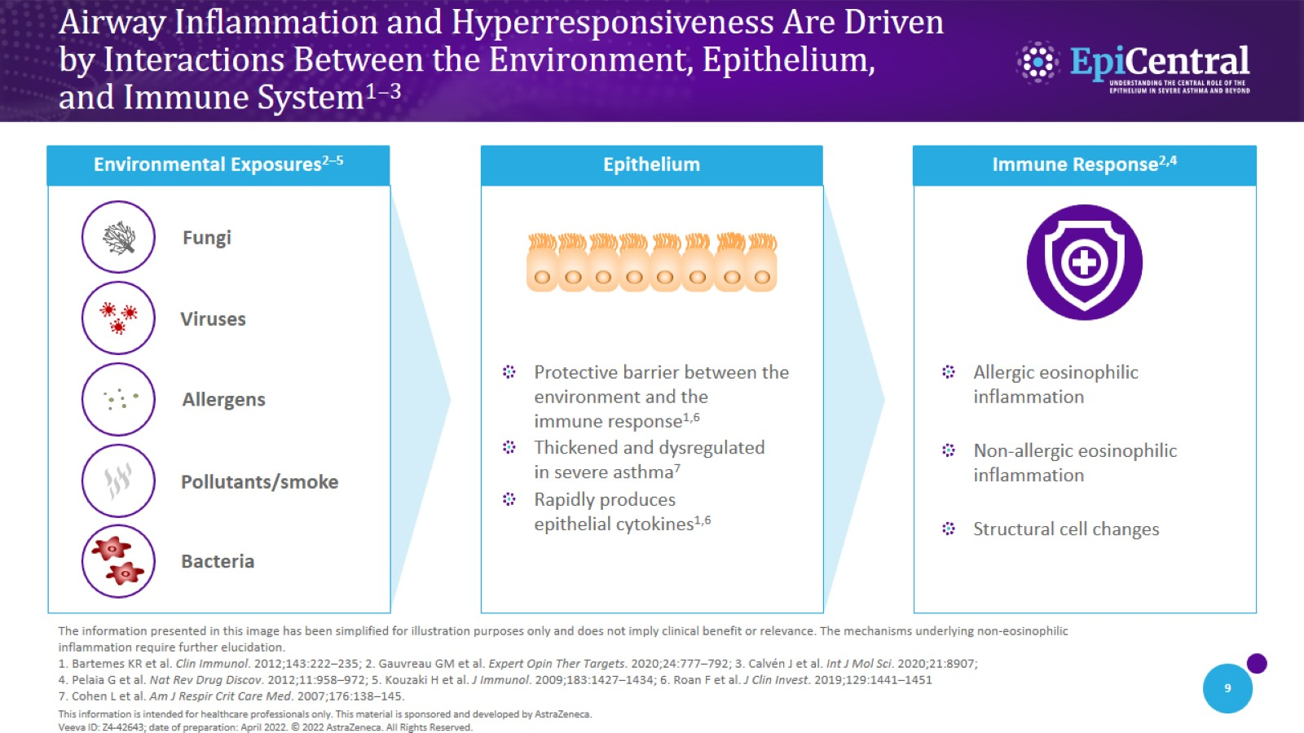
Airway Inflammation and Hyperresponsiveness Are Driven by Interactions Between the Environment, Epithelium, and Immune System^{1–3}

Slide 10
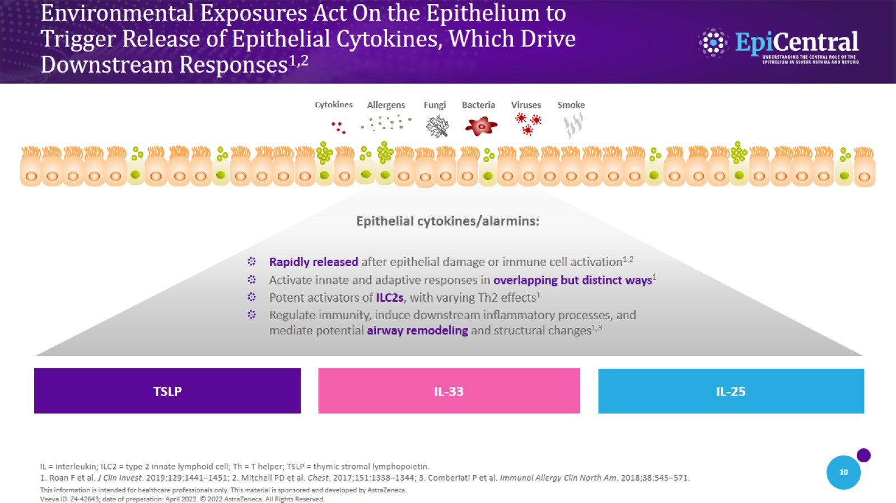
Environmental Exposures Act On the Epithelium to
Trigger Release of Epithelial Cytokines, Which Drive
Downstream Responses^{1,2}

Slide 11
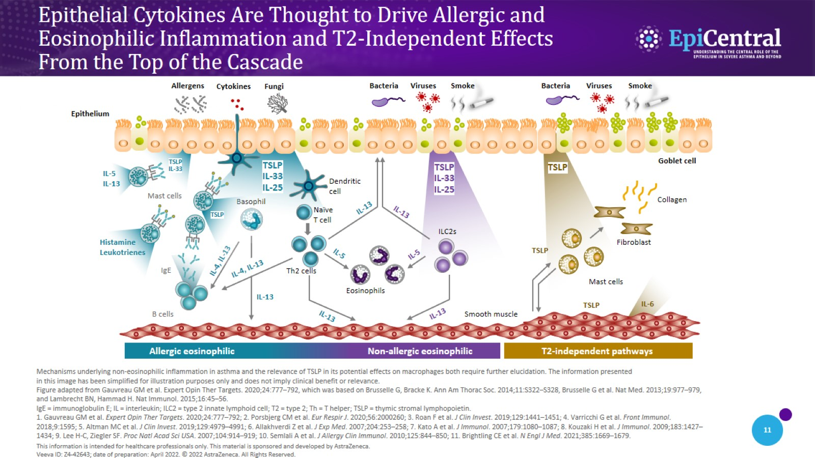
Epithelial Cytokines Are Thought to Drive Allergic and
Eosinophilic Inflammation and T2-Independent Effects
From the Top of the Cascade

Slide 12
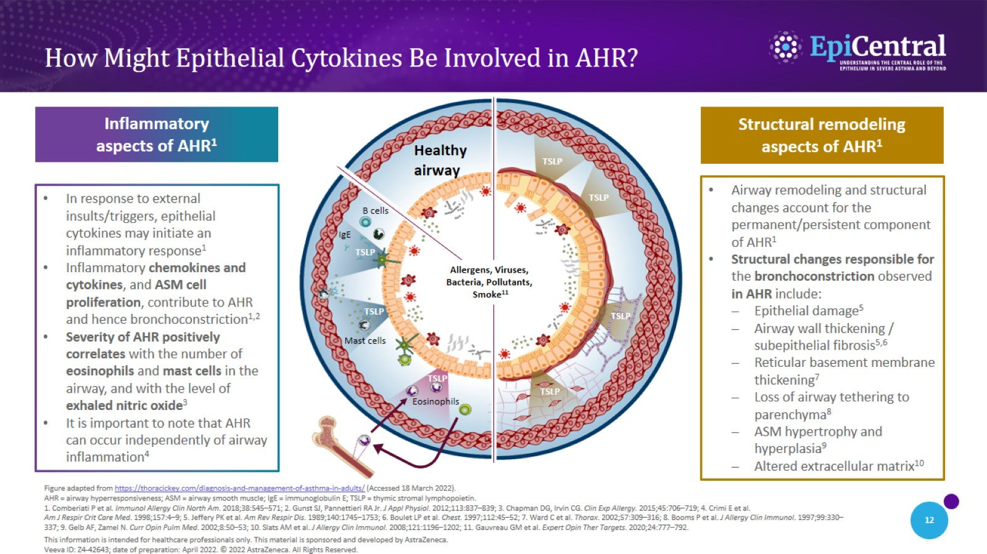
How Might Epithelial Cytokines Be Involved in AHR?

Slide 13

Epithelial Cytokines in
Severe Asthma

Slide 14
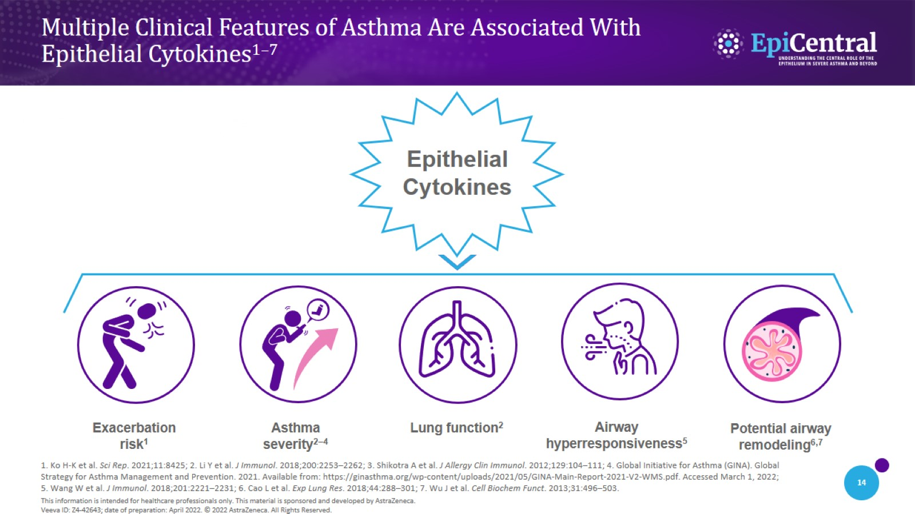
Multiple Clinical Features of Asthma Are Associated With
Epithelial Cytokines^{1–7}

Slide 15
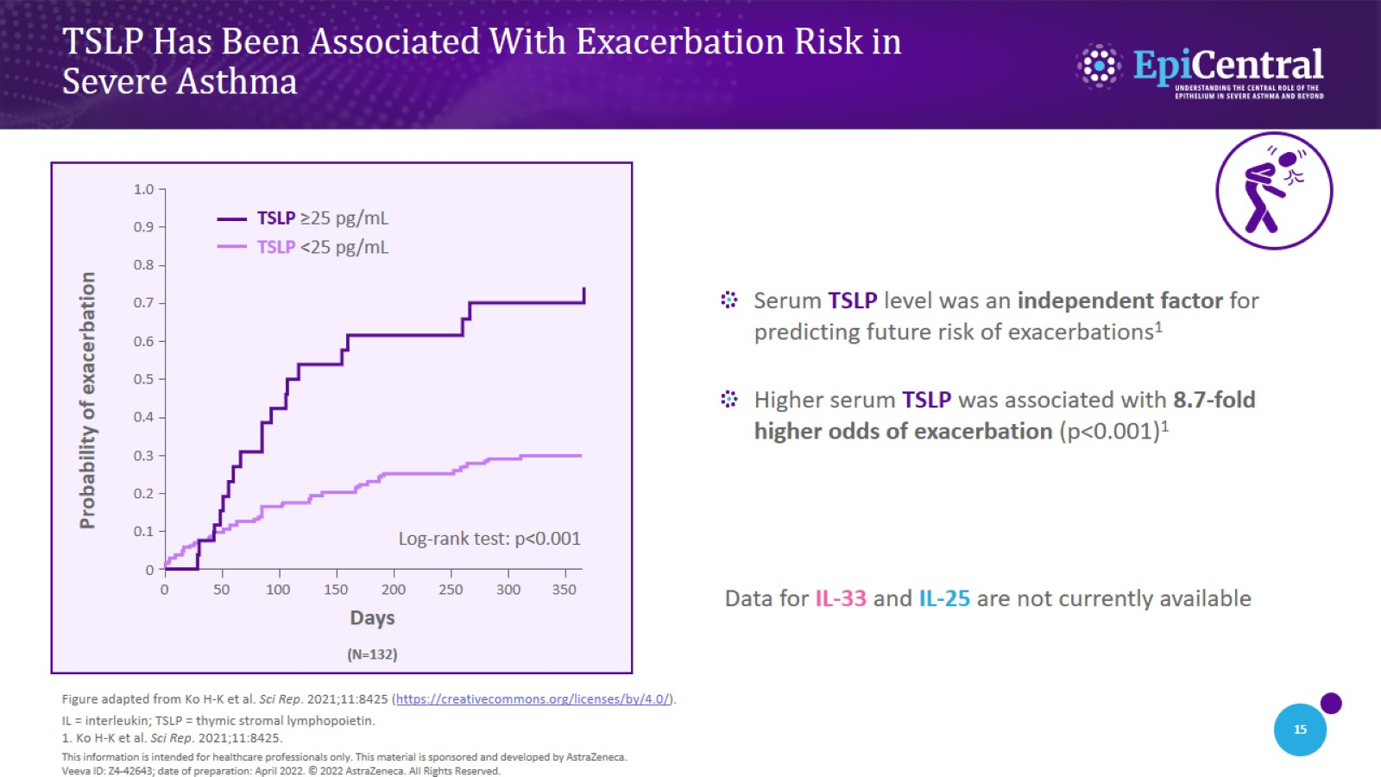
TSLP Has Been Associated With Exacerbation Risk in
Severe Asthma

Slide 16
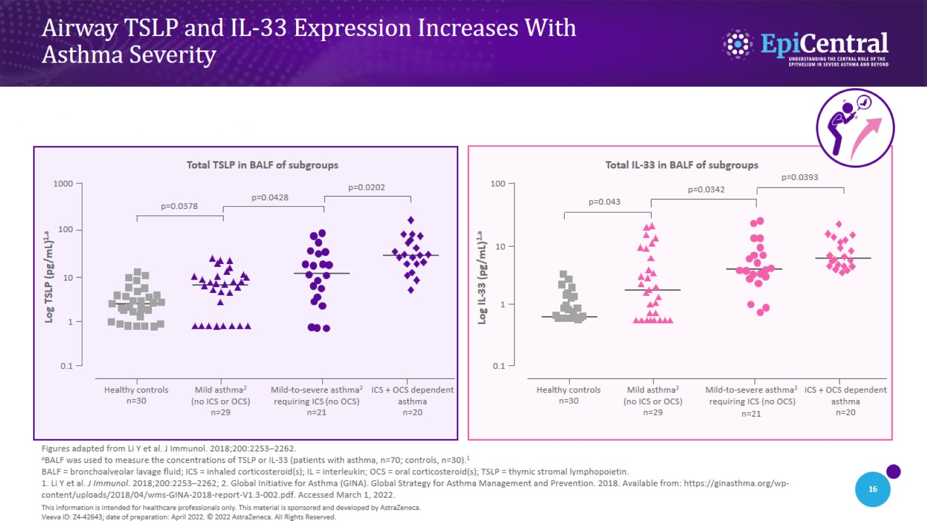
Airway TSLP and IL-33 Expression Increases With
Asthma Severity

Slide 17
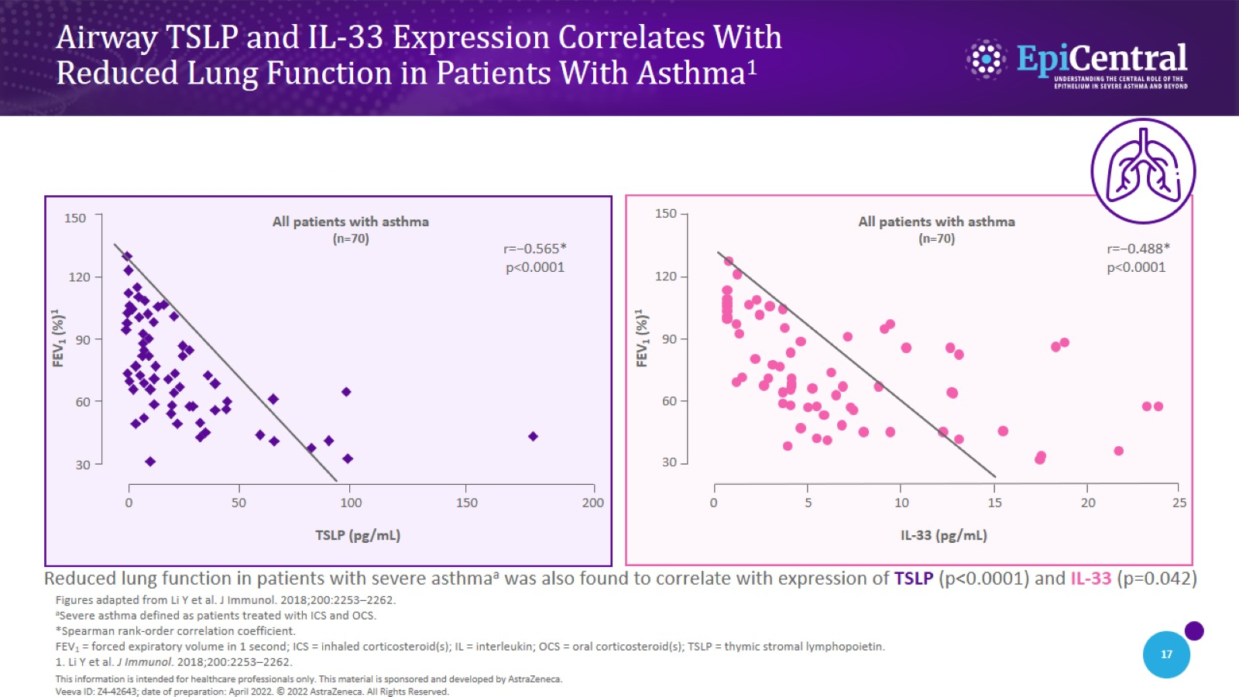
Airway TSLP and IL-33 Expression Correlates With
Reduced Lung Function in Patients With Asthma¹

Slide 18
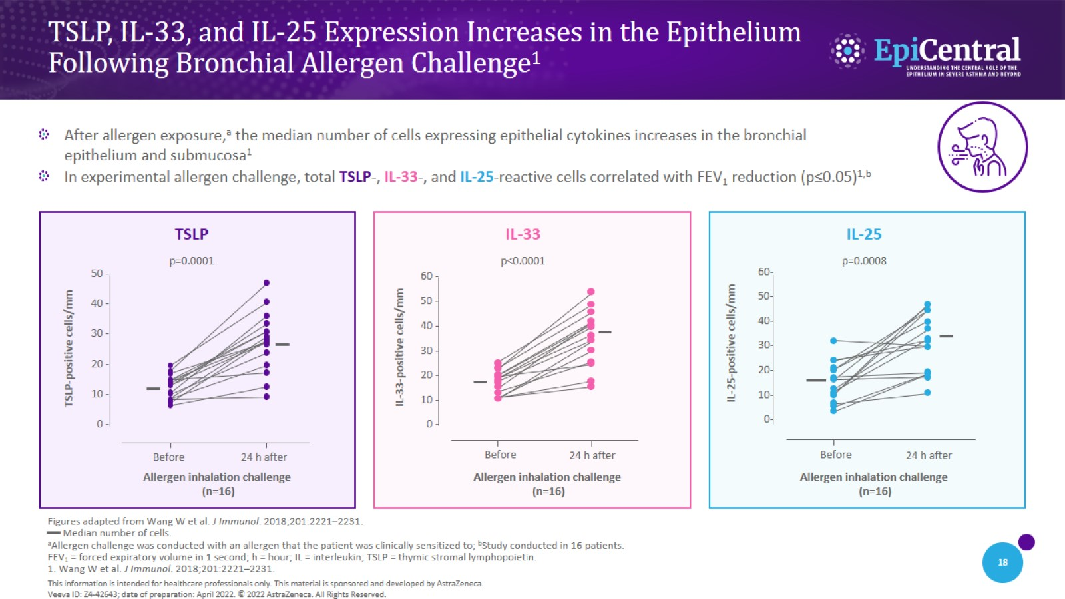
TSLP, IL-33, and IL-25 Expression Increases in the Epithelium
Following Bronchial Allergen Challenge¹

Slide 19
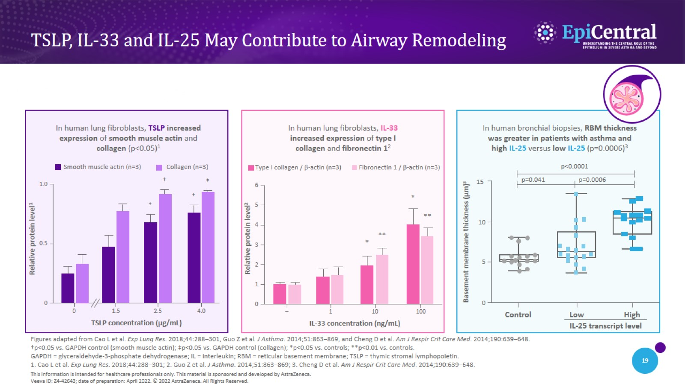
TSLP, IL-33 and IL-25 May Contribute to Airway Remodeling

Slide 20
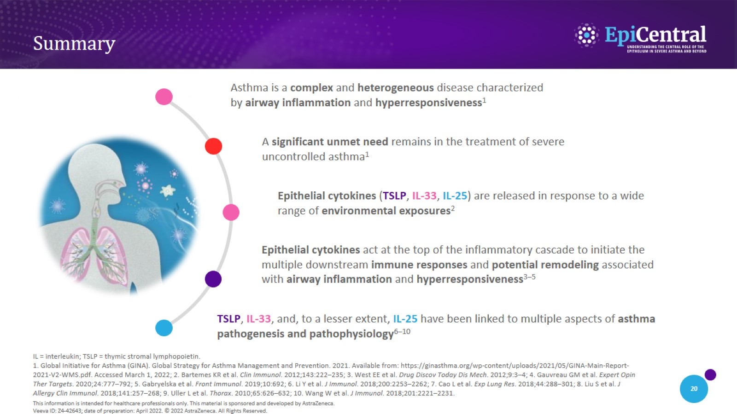
Summary

